Slide 1
Computer Architecture Experiment
Topic 6. Pipelined CPU supporting
Interrupt
浙江大学计算机学院
陈文智
chenwz@zju.edu.cn

Slide 2
实验操作流程
阅读实验文档，理解CP0的工作原理和中断相关机制的实现方式
以前一次实验为基础，增加协处理器CP0，支持中断指令及中断相关机制
对处理器进行仿真，检验处理器的仿真结果是否符合要求。
综合工程并下载至开发板，在单步执行的过程中检查调试屏幕的输出，检验处理器的执行过程是否正确。

Slide 3
实验验收标准
仿真执行过程中，处理器的行为和内部控制信号均符合要求。
下载至开发板后的单步执行过程中，寄存器的变化过程和最终执行结果与测试程序相吻合。

Slide 4
Outline
Experiment Purpose
Experiment Task
Basic Principle
Operating Procedures
Precaution
Checkpoints

Slide 5
Experiment Purpose
Understand the principle of CPU Interrupt and its processing procedure.
Understand the function of CP0 coprocessor.
Master the design methods of pipelined CPU supporting interrupt.
master methods of program verification of Pipelined CPU supporting interrupt.

Slide 6
Experiment Task
Design of Pipelined CPU supporting Interrupt.
Design CP0
Design CPU Controller
Design datapath
Verify the Pipelined CPU with program and observe the execution of program

Slide 7
What jobs does CP0 do?
CPU conﬁguration
Cache control
Exception/interrupt control
Memory management unit control
Miscellaneous
Notes:
select major features of the CPU (such as its endianness) or alter the way the system interface works
One or more internal registers provide control and visibility of these options.
There’s always more: timers, event counters, parity error detection.

Slide 8
Exception/interrupt control
CP Instructions
Simple interrupt control
Some Mechanisms
Simple CP0 design
Code Example

Slide 9
CP Interrupt Instructions (1)
Register index bits: 5 bits.
MIPS32 uses another 3 bits “SEL” to extend index bits
CP0 Interrupt Instructions
MTC0
MFC0
ERET

Slide 10



CP Interrupt Instructions (2)
Format: MFC0 rt, rd, sel
Function: GPR[rt] = CPR[0, rd, sel]
Format: MTC0 rt, rd, sel
Function: CPR[0, rd, sel] = GPR[rt]
ERET

Slide 11
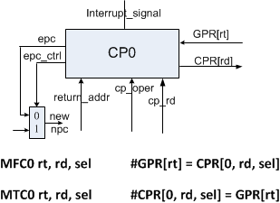
Simple interrupt control (1)

Slide 12
Simple interrupt control (2)
Interrupt is detected
Instructions in IF is killed ( ID_RST= 1)
Return address (Delay slot)
Interrupt returns
Modify npc
Notes:
遇到branch时(其下一条已经提前开始做了)，中断返回要返回branch指令，而不是branch指令的下一条

Slide 13
Some Mechanisms
Interrupt signal should be saved
Interrupt handler could not be re-entered
Notes:
CPU在处理中断时，不能接受新的中断

Slide 14
Simple CP0 design
Interrupt register file
Exception Handler Base Register (EHBR)
Exception Program Counter Register (EPCR)
MTC0: Write Interrupt register file
MFC0: Read Interrupt register file
Interrupt is detected: jump to EHBR (External signal)
ERET: jump to EPCR (From CPU controller)

Slide 15
Code Example (1)
module cp0 (
input wire clk, // main clock
// debug
`ifdef DEBUG
input wire [4:0] debug_addr, // debug address
output reg [31:0] debug_data, // debug data
`endif
// operations (read in ID stage and write in EXE stage)
input wire [1:0] oper, // CP0 operation type
input wire [4:0] addr_r, // read address
output reg [31:0] data_r, // read data
input wire [4:0] addr_w, // write address
input wire [31:0] data_w, // write data
// exceptions (check exceptions in MEM stage)
input wire rst, // synchronous reset
input wire ir_en, // interrupt enable
input wire ir_in, // external interrupt input
input wire [31:0] ret_addr, // target instruction address to store when interrupt occurred
output reg jump_en, // force jump enable signal when interrupt authorised or ERET occurred
output reg [31:0] jump_addr // target instruction address to jump to
);

Slide 16
Code Example (2)
// interrupt determination
wire ir;
reg ir_wait = 0, ir_valid = 1;
reg eret = 0;
always @(posedge clk) begin
if (rst)
ir_wait <= 0;
else if (ir_in)
ir_wait <= 1;
else if (eret)
ir_wait <= 0;
end
always @(posedge clk) begin
if (rst)
ir_valid <= 1;
else if (eret)
ir_valid <= 1;
else if (ir)
ir_valid <= 0; // prevent exception reenter
end
assign ir = ir_en & ir_wait & ir_valid;

Slide 17
Code Example (3)
// Exception Handler Base Register
always @(posedge clk) begin
……
end
// Exception Program Counter Register
always @(posedge clk) begin
……
end
// jump determination
always @(*) begin
……
end

Slide 18
Code Example (4)
// CP0 registers
localparam
//CP0_SR = 0,
//CP0_EAR = 1,
CP0_EPCR = 2,
CP0_EHBR = 3;
//CP0_IER = 4,
//CP0_ICR = 5,
//CP0_PDBR = 6,
//CP0_TIR = 7,
//CP0_WDR = 8;
// EXE CP operations
localparam
EXE_CP_NONE = 0,
EXE_CP_STORE = 1,
EXE_CP0_ERET = 2;

Slide 19
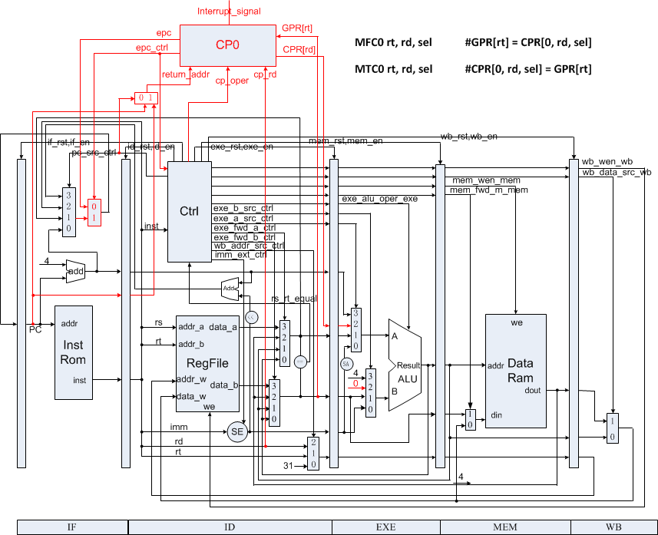
Datapath of CPU supporting interrupt.

Slide 20
Instr. Mem.(3)
0: 3c010000 lui R1,0x0 //main entry
4: 24210020 addiu R1,R1,32
8: 40811800 mtc0 R1, R3
c: 00001020 add R2,R0,R0
10: 00001820 add R3,R0,R0
14: 20420001 addi R2,R2,1 //loop
18: 08000005 j 14
1c: 00000000 nop
20: 40041000 mfc0 R4,R2 //handler
24: 20630001 addi R3,R3,1
28: 42000018 eret
2c: 00000000 nop

Slide 21
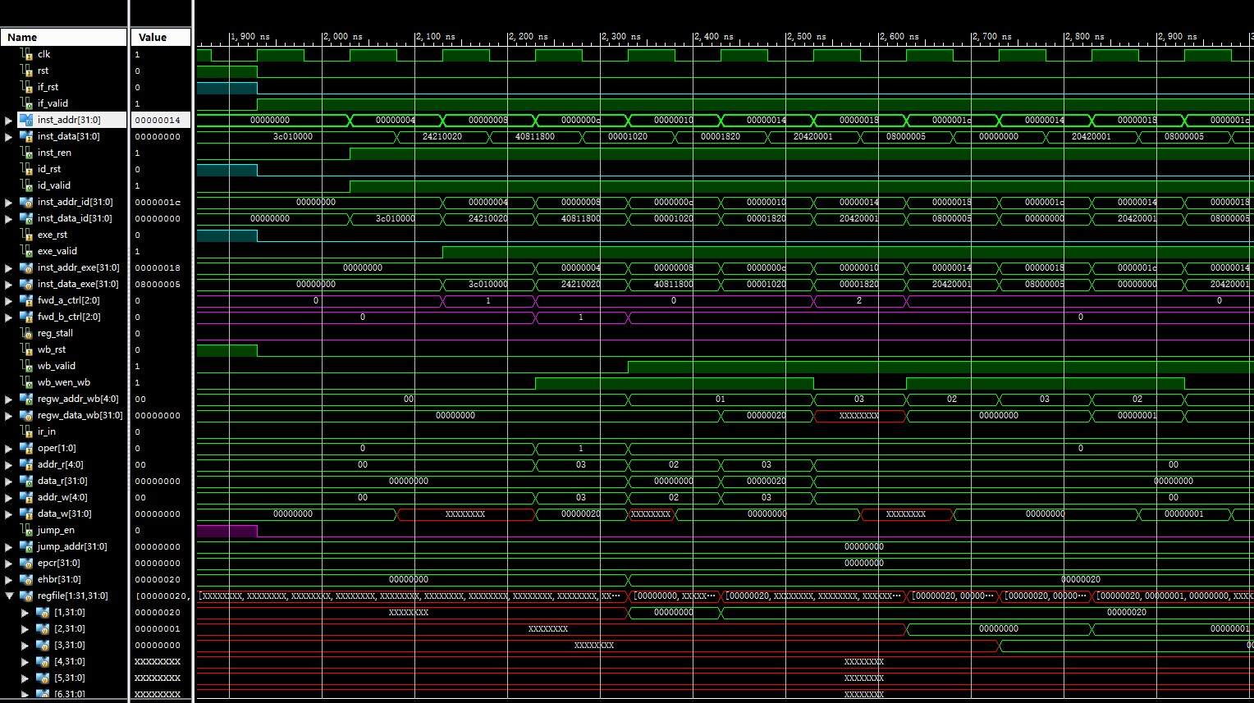
Simulation (1)

Slide 22
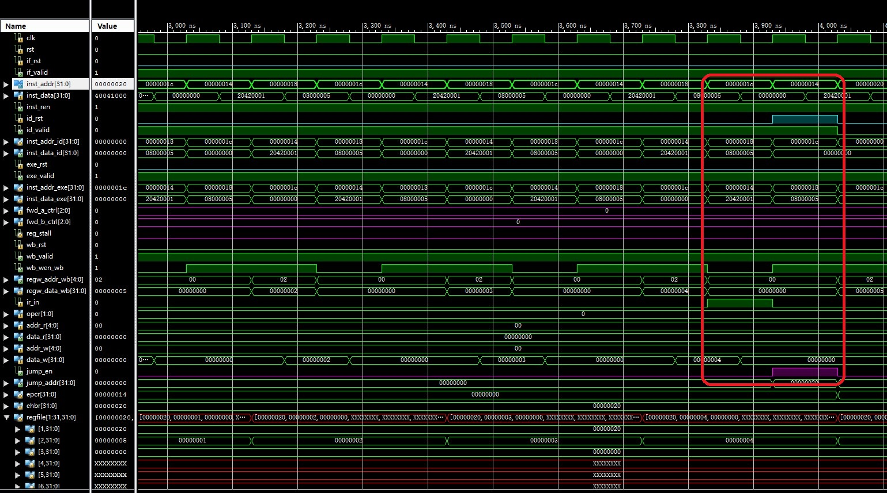
Simulation (2)

Slide 23
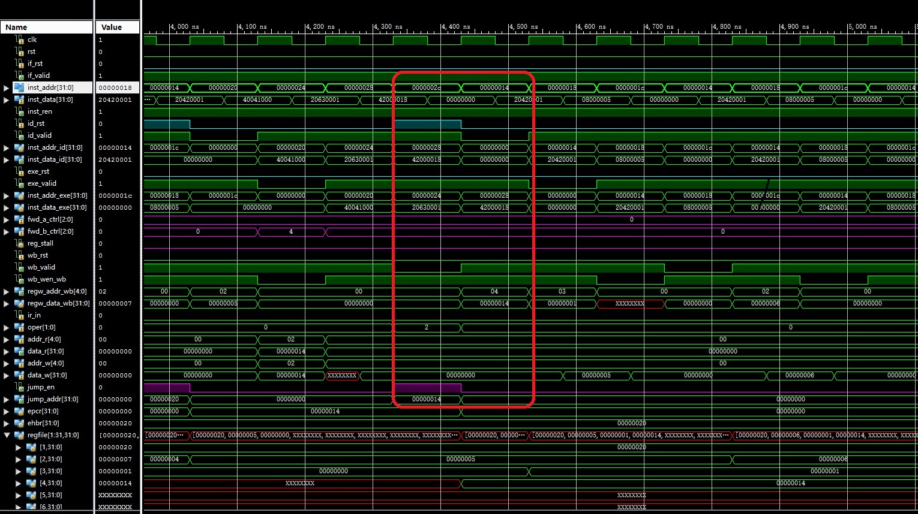
Simulation (3)

Slide 24
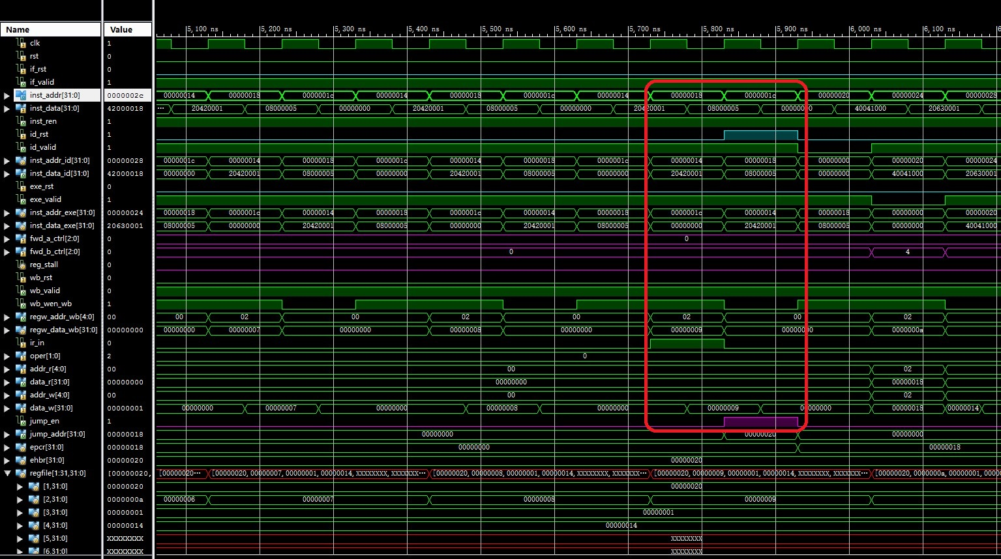
Simulation (4)

Slide 25
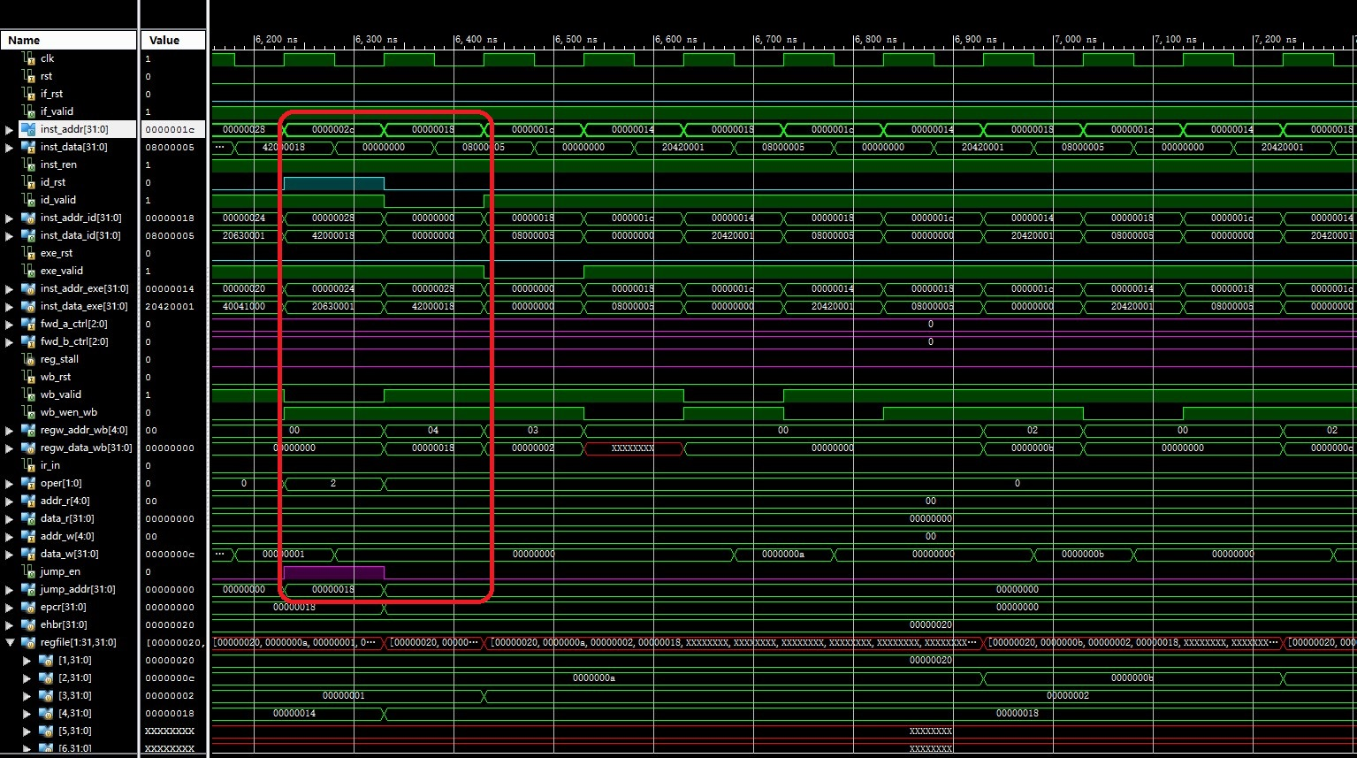
Simulation (5)

Slide 26
FPGA
// interrupt
wire interrupt;
reg interrupt_prev;
always @(posedge clk) begin
interrupt_prev <= interrupter;
end
assign interrupt = ~interrupt_prev & interrupter;
Interrupter：West Button
Interrupt is triggered at posedge of West Button’s Pushing

Slide 27
Checkpoints
CP 1:
Waveform Simulation of the Pipelined CPU with the verification program
CP 2:
FPGA Implementation of the Pipelined CPU with the verification program

Slide 28
Thanks!

